Slide 1
Esof 423
Rivernet-2
Axel, Jared, Ahmed

Slide 2

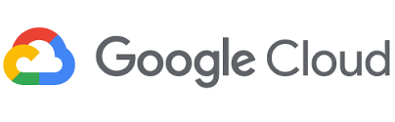
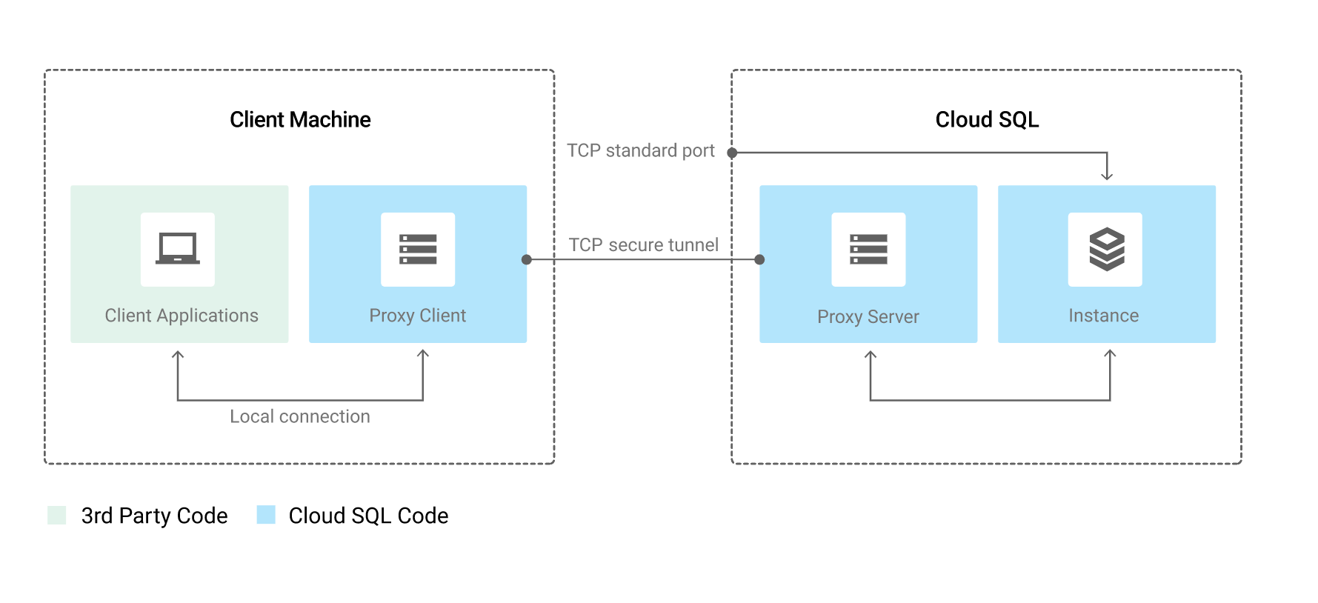
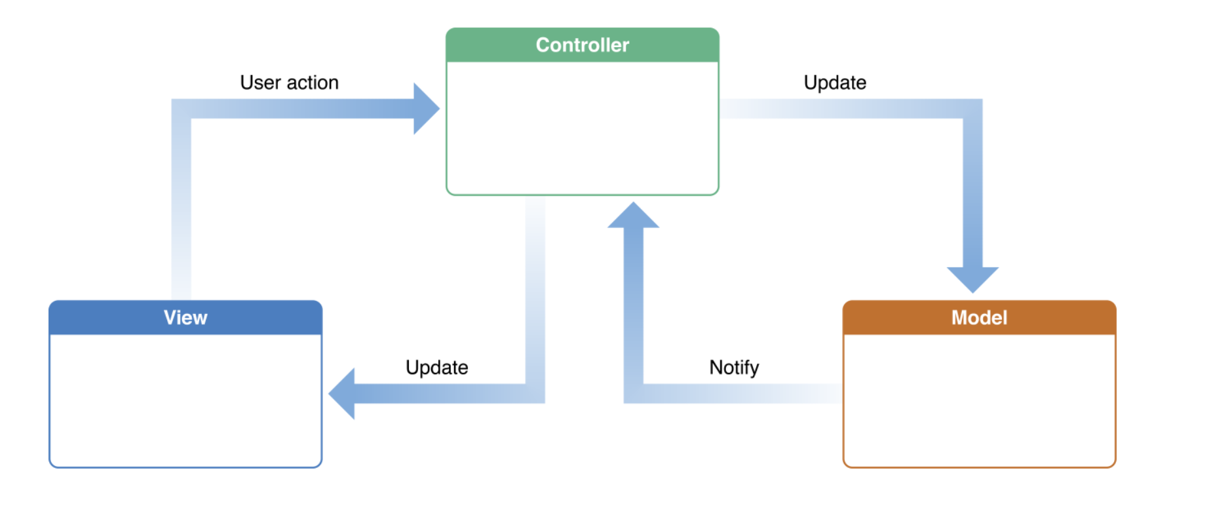
System Architecture
Model, View, Controller - pattern describes system wide architecture
Hosted on Google App Engine; mySQl database
Notes:
MVC - Django loosely follows a model-view-controller architecture, though the names are somewhat mixed up. Everything is passed through or between views.py which, per MVC, acts as the “controller” for the system. Views can call the Model to query or put data into or from the database, call any other class within the site to perform business logic, and then finally concludes by rendering the html. Here then, HTML and any Javascript is the “views” portion of MVC while Model is the model.
We used GCLOUD APP Engine to host our platform because it had the best documentation and our group had some familiarity with it. In order to test our code locally we had to build a database within the cloud and use a proxy on our site to reach it. When the app is deployed this isn’t an issue because both the database

Slide 3
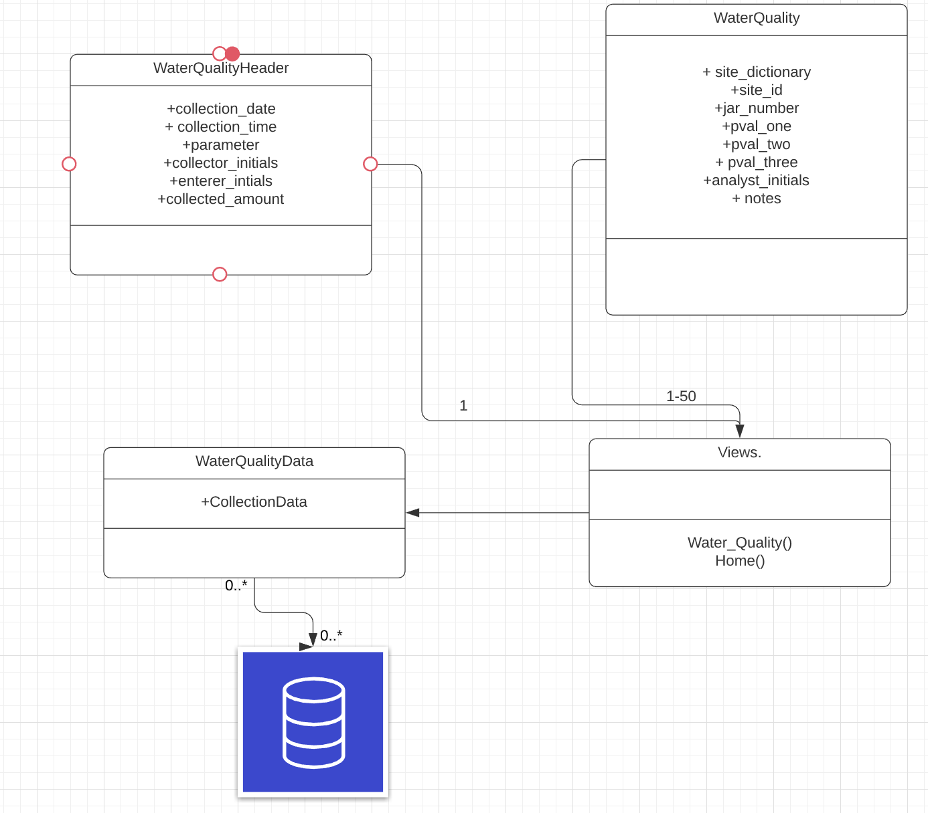
System Design
Primary Components:
Views.py
Models.py
Forms.py
Template HTML
Home.html
Index.html
Water_quality.html
Secondary Components:
Rivernet_api.py
Admin.py
Apps.py
Ursl.py
Configuration classes

Slide 4
Design Choices and Extensibility
Extensible Form Collection
JSON Data Saving
Allows for plug and play form collection across any site within the platform
Makes cross site integration easier
Per Roby’s request, allows getting and saving with no data manipulation
Makes it easier to integrate with other cloud services
Notes:
MVC - Django loosely follows a model-view-controller architecture, though the names are somewhat mixed up. Everything is passed through or between views.py which, per MVC, acts as the “controller” for the system. Views can call the Model to query or put data into or from the database, call any other class within the site to perform business logic, and then finally concludes by rendering the html. Here then, HTML and any Javascript is the “views” portion of MVC while Model is the model.
We used GCLOUD APP Engine to host our platform because it had the best documentation and our group had some familiarity with it. In order to test our code locally we had to build a database within the cloud and use a proxy on our site to reach it. When the app is deployed this isn’t an issue because both the database and the

Slide 5
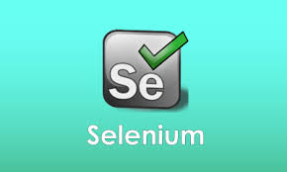
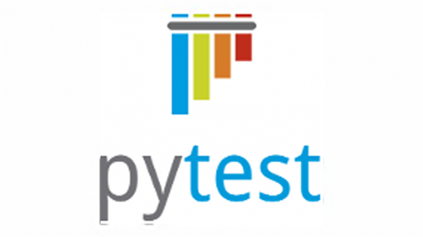
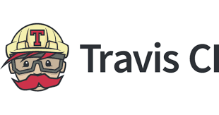
Quality assurance method
Unit Testing
Django.Tests
System Testing
Selenium
User Testing
User 1
User 2

Slide 6
Demo

